Slide 1
Bridging the Gaps: Exploring Association Between Insurance Coverage and Healthcare Utilization/Access among Chronic Kidney Disease (CKD) Patients in US
Janice Ye

Slide 2
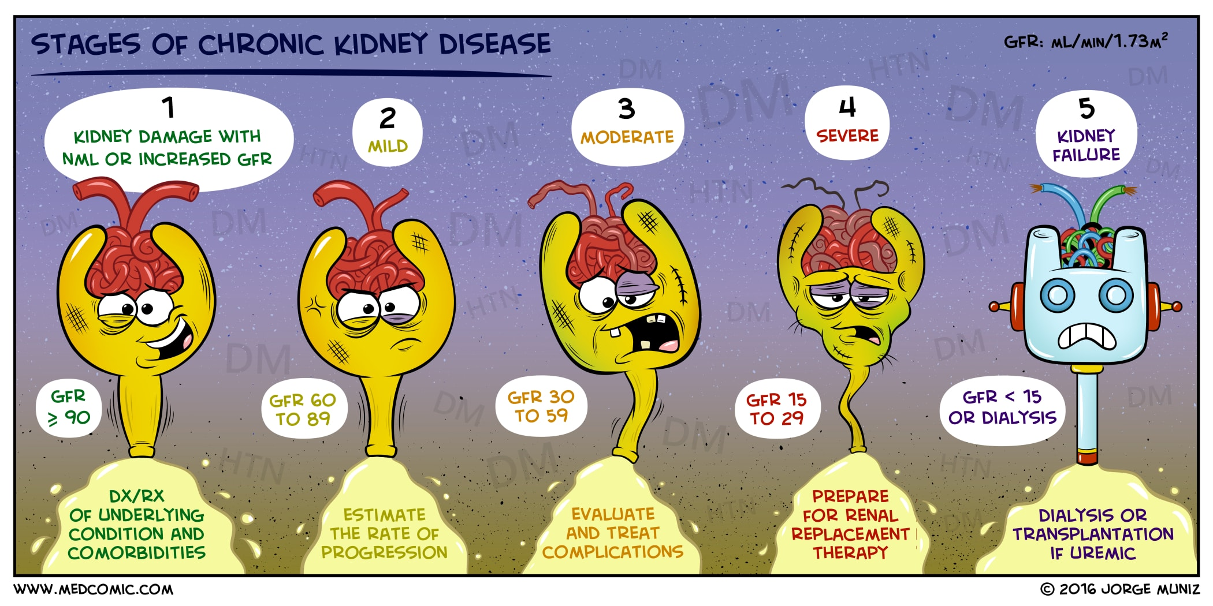
Background

Slide 3

Background
~ 1 k / treatment
~ 3 / week, 52 weeks
~ Total : 156 k / year

Slide 4
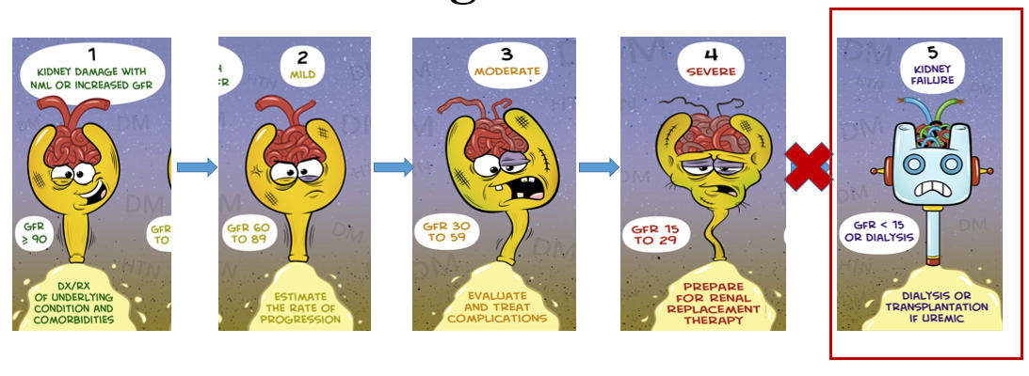
Objectives
To explore the possible impact of insurance expansion on health utilization and access by addressing the gaps between insured and uninsured CKD patients at their early stages.
Provide early intervention for patients in stage 1 – 4.

Slide 5
Data & Methods
Outcomes:
Measure if the patients has access to insurance coverage facilities
Access to outpatient & inpatient visit
Predictors:
Insurance coverage Y/N
Private or Public
Demographic: age, gender, race….
Methods:
Logistic regression, passion regression

